Slide 1
Lecture 23: Anomalies in Galactic Motion

Slide 3
Gaia Satellite
Gaia;s main mode of measure is the Parallax
This translates to a distance away from us
Many measurements yields a velocity vector

Slide 4
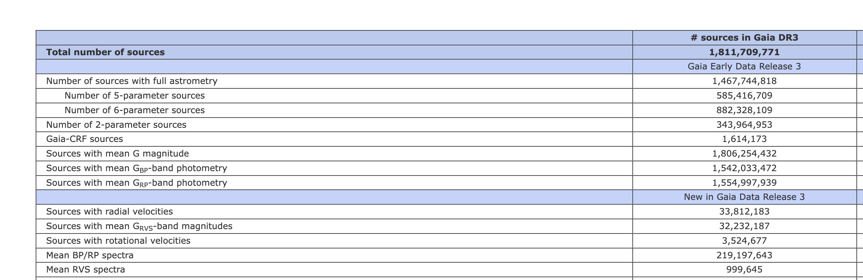
Full Gaia Stats
Gaia has been running for the past 10 years

Slide 5
Star Observations

Slide 6
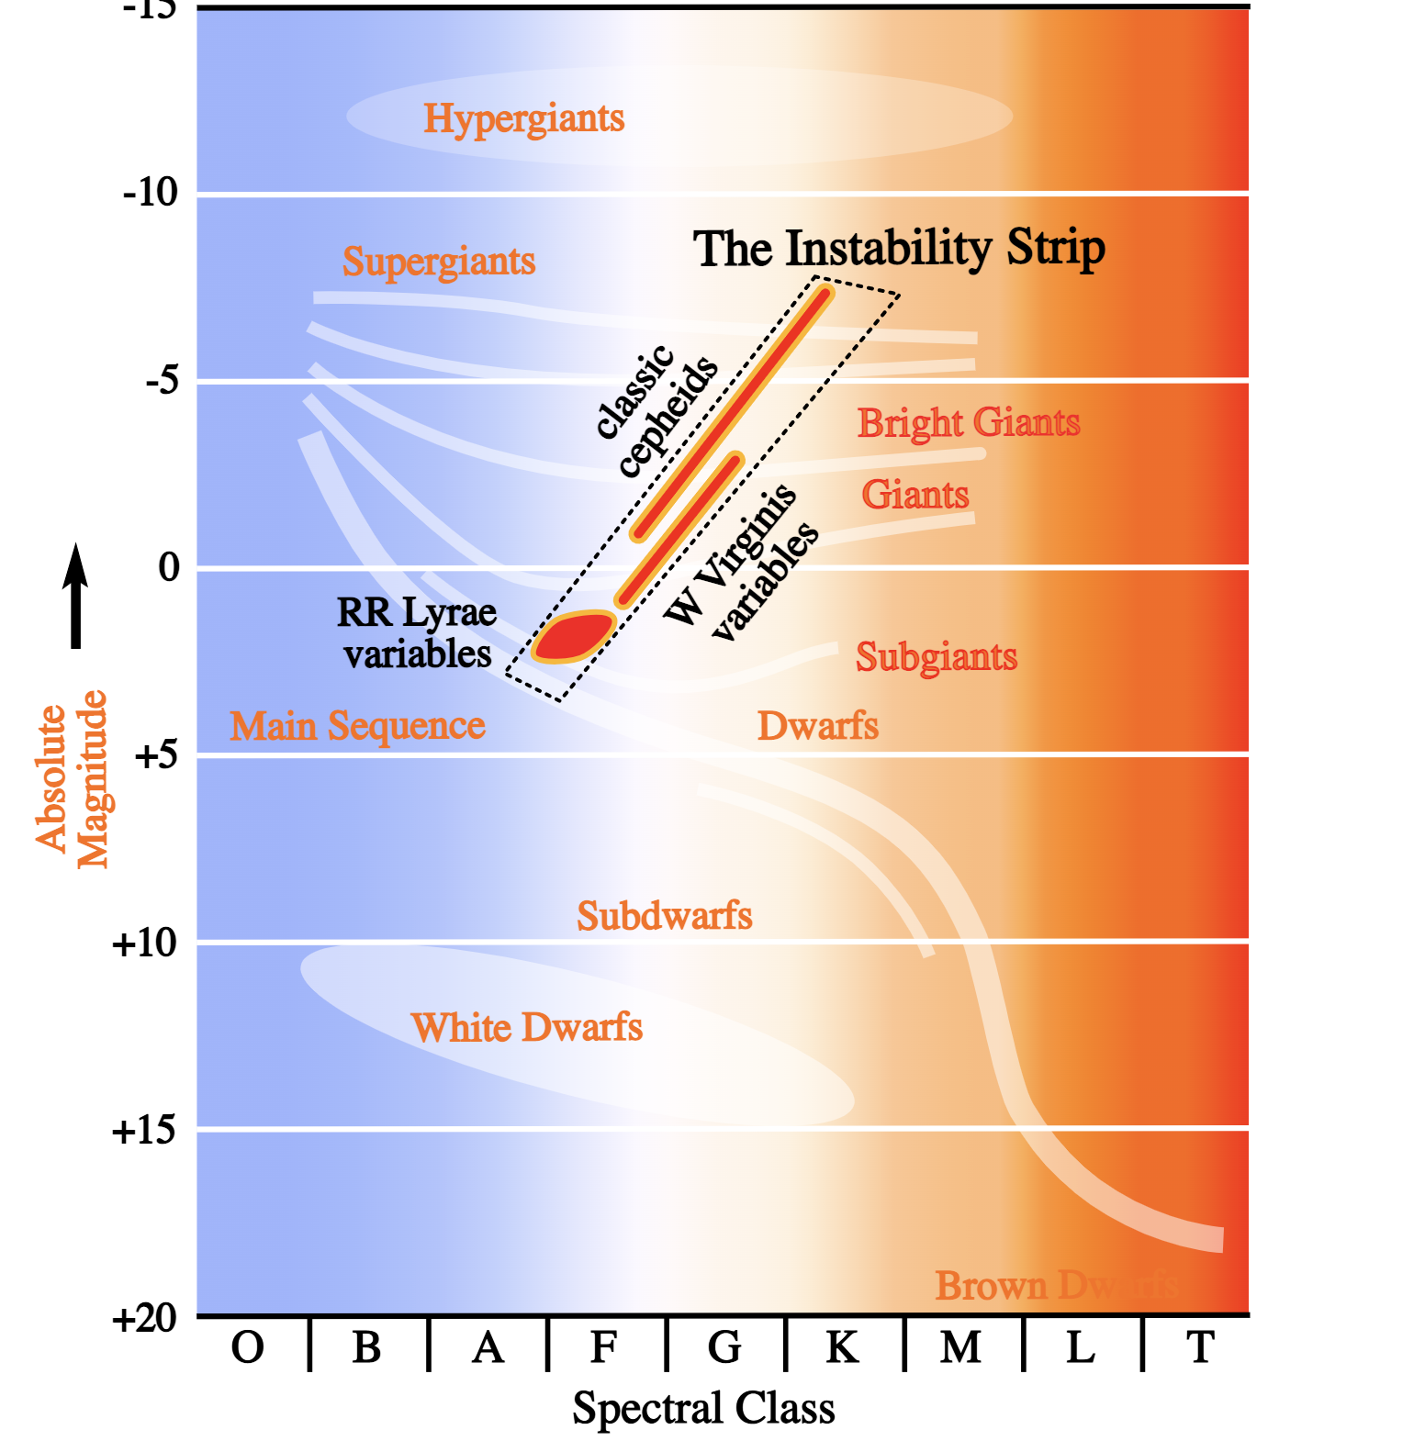
Star Evolution
Hertzpring Russell diagram devots fate of star

Slide 7
Star Observations

Slide 8
Star Observations

Slide 9
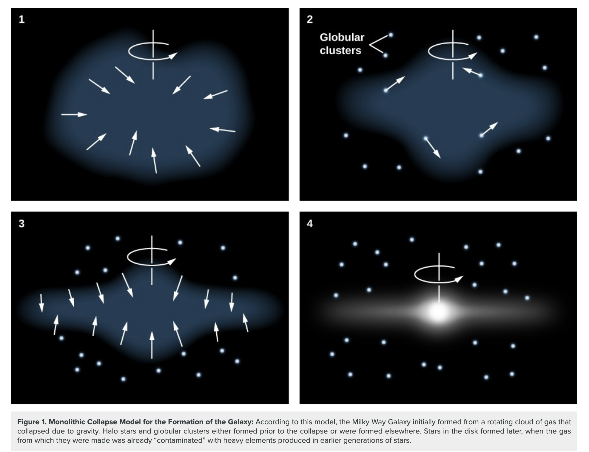
Star Observations

